Slide 1


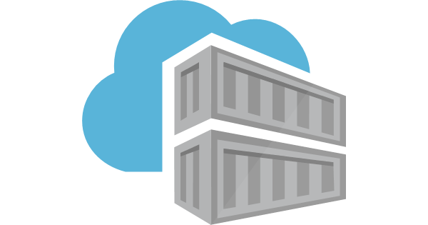
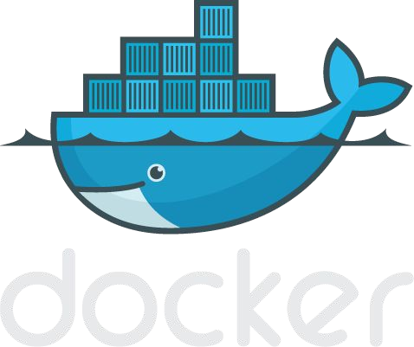
Introduction to Docker

Slide 2
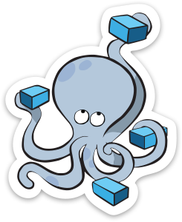
Agenda
Section 1:
What is Container
Docker vs Virtual machine
What is Docker
Dev vs Operations & Vocabs
Section 3:
Docker commands in detail
Run, create, build, tag
Docker hub, push
Section 2:
Docker Installation
Docker commands
Dockerfile
Section 4:
Docker Expose
Docker Compose
Docker Swarm vs K8s

Slide 3
Section 1:
- What is Container
- Docker Vs Virtual machine
- Into Docker
- Common Vocabs

Slide 4
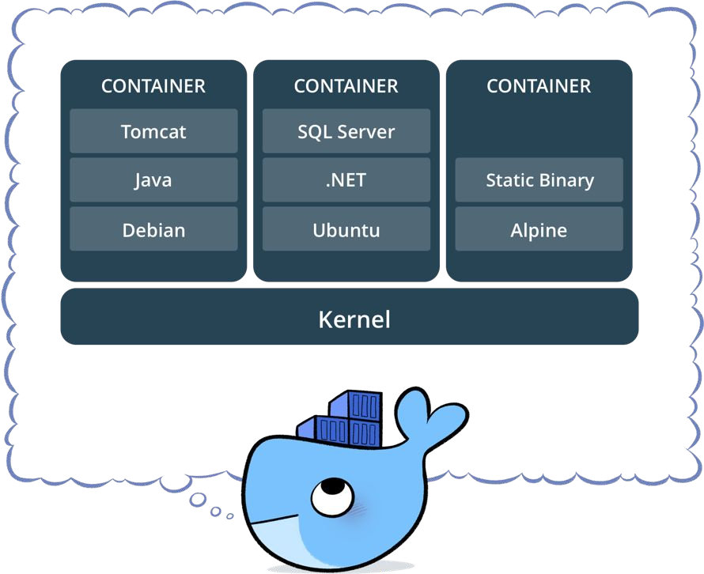
What is a container?
Standardized packaging for software and dependencies
Isolate apps from each other
Share the same OS kernel
Works for all major Linux distributions

Slide 5
Question to Mazz and Ramesh
Have you come across S/W problems?
Works in your machine but not other
Reason?
a) Dependencies
b) Configuration difference
c) Operating system

Slide 6
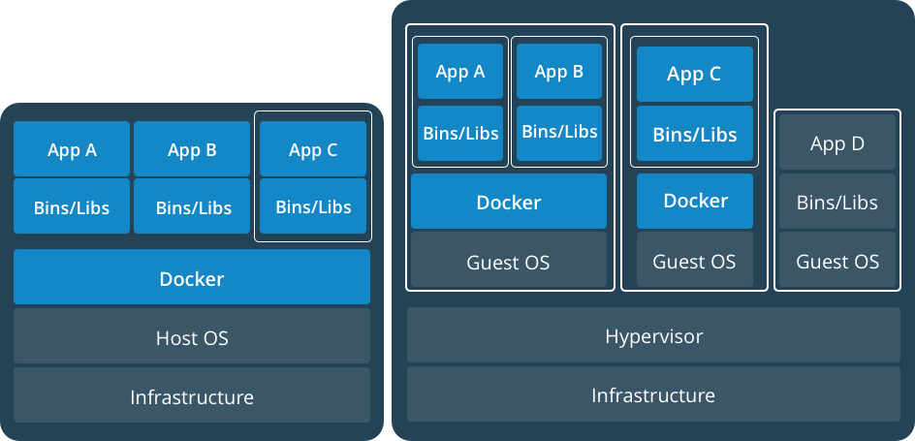
Docker Containers Versus Virtual Machines
App 1
App 2
Bins/Libs
Bins/Libs
Guest OS
Guest OS
App 1
App 2
Bins/Libs
Bins/Libs
Hypervisor
Docker Engine
Host Operating System
Host Operating System
Virtual Machines
Docker Containers

Slide 7
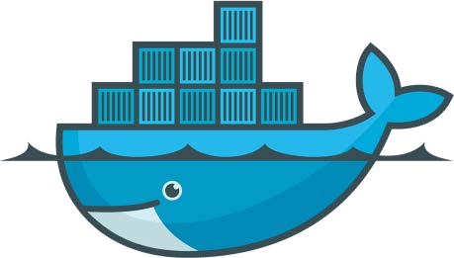
Lightweight, open, secure platform for packaging and image creation
What Is Docker?
Runs natively on Linux or Windows Server
Runs on Windows or Mac Development machines (with a virtual machine)
Relies on "images" and "containers"
Provides Environment for execution

Slide 8
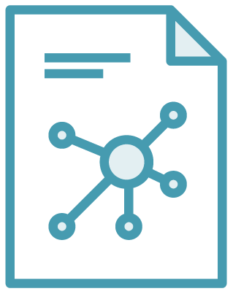

The Role of Images and Containers
Docker Image
Docker Container
Example: Ubuntu with Node.js and Application Code
Created by using an image. Runs your application.

Slide 9
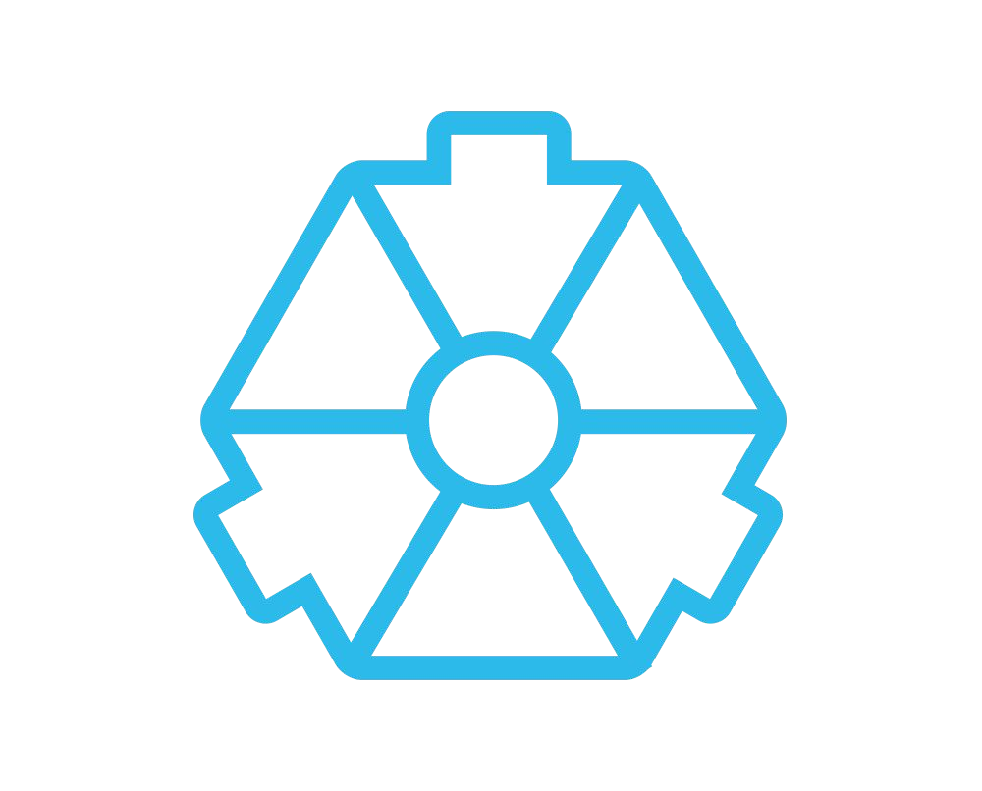
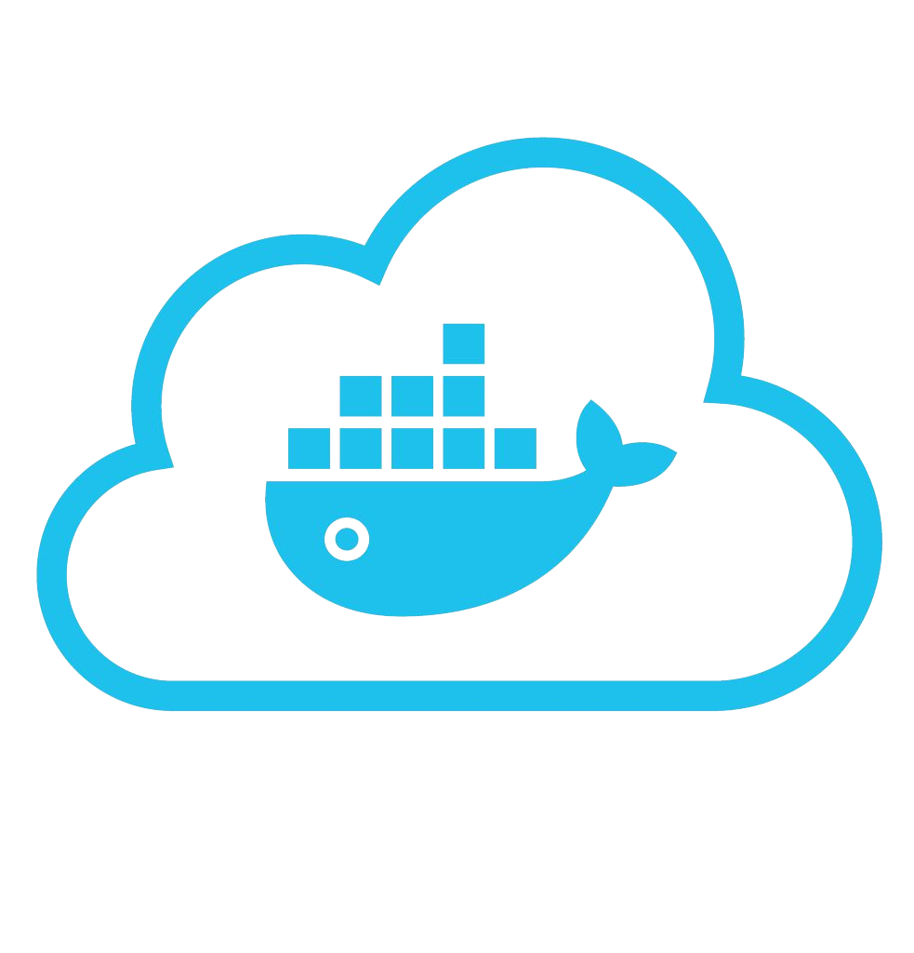
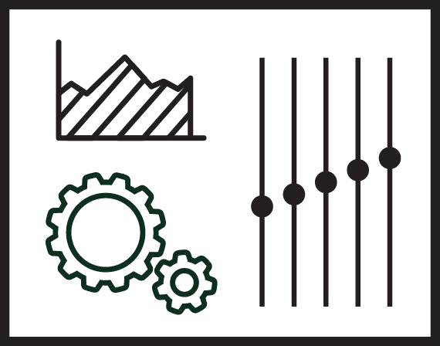



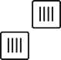

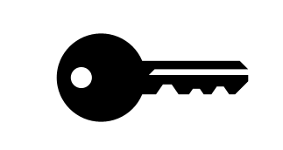



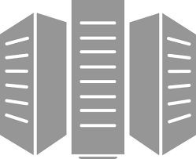
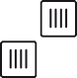


Using Docker: Build, Package, Run Workflow
Developers IT Operations
BUILD
Development Environments
Package
Create & Store Images
RUN
Deploy, Manage, Scale

Slide 10




Common Docker vocabularys
z
Docker Image
The basis of a Docker container. Represents a full application
Docker Container
The standard unit in which the application service resides and executes
Docker Engine
Creates, ships and runs Docker containers deployable on a physical or virtual, host locally, in a datacenter or cloud service provider
Registry Service (Docker Hub(Public) or Docker Trusted Registry(Private))
Cloud or server based storage and distribution service for your images

Slide 11
Section 2:
Docker Installation
Docker Basic Commands
Dockerfile

Slide 12
Docker Installation
Mac :
https://docs.docker.com/desktop/mac/install/
Linux:
https://docs.docker.com/engine/install/ubuntu/

Slide 13
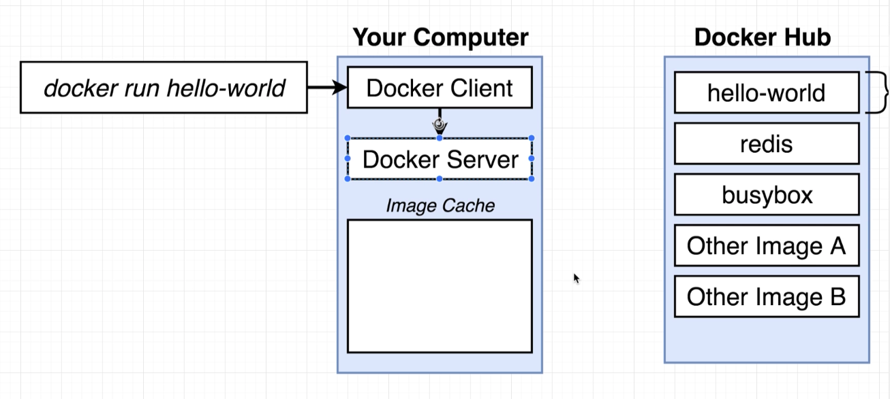
Basic Docker Commands
$ docker version
$ docker run hello-world
hello-world

Slide 14
Basic Docker Commands
$ docker run <image name> <command>
$ docker run busybox ls –lrt
$ docker run busybox ping google.com
$ docker ps
$ docker ps –all
Explanation of Docker run
docker run = docker create + docker start
Create will download
Start –a will initiate the image to make a container (running image)

Slide 15
Basic Docker Commands
Remove unused containers
$ docker system prune
Get logs
$ docker run busybox ping google.com
$ docker logs <containerid>
Graceful stop and kill and delete local images
$ docker stop <container id>
$docker kill <container id>
$ docker rmi -f $(docker images -a -q)

Slide 16
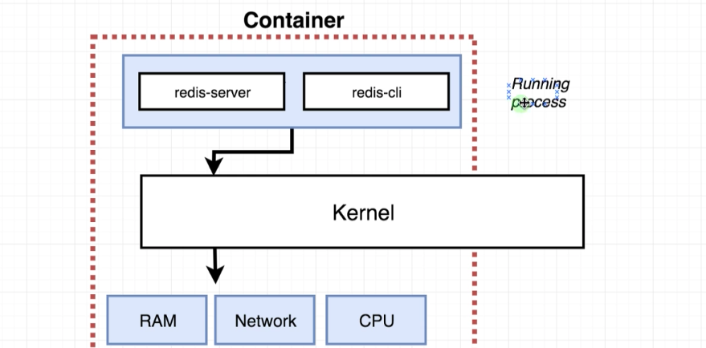
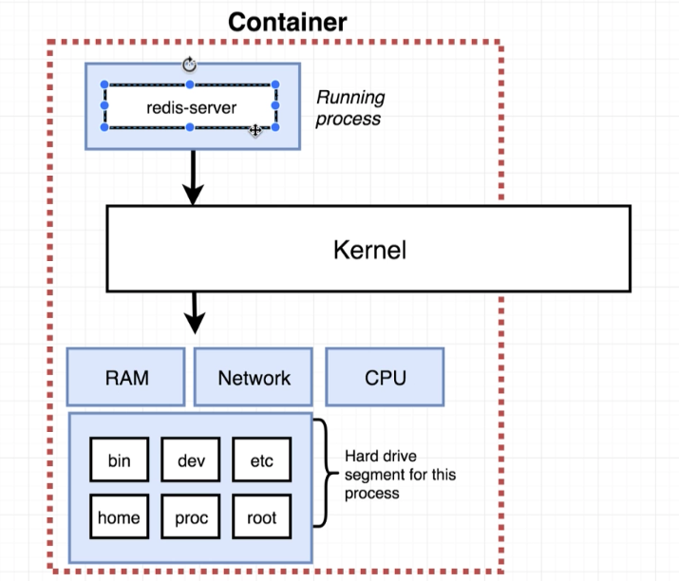
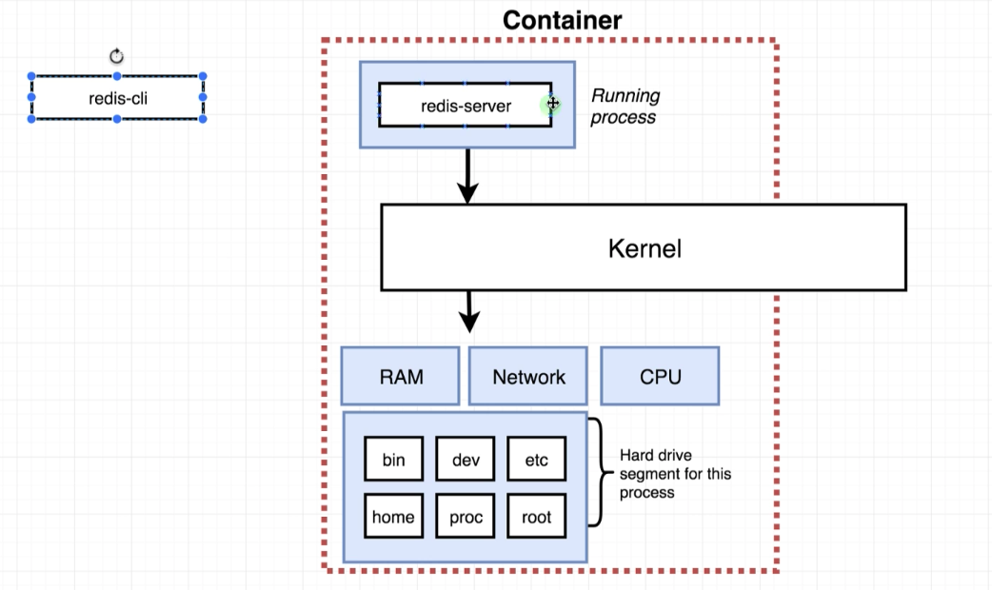
How to use container as software

Slide 17
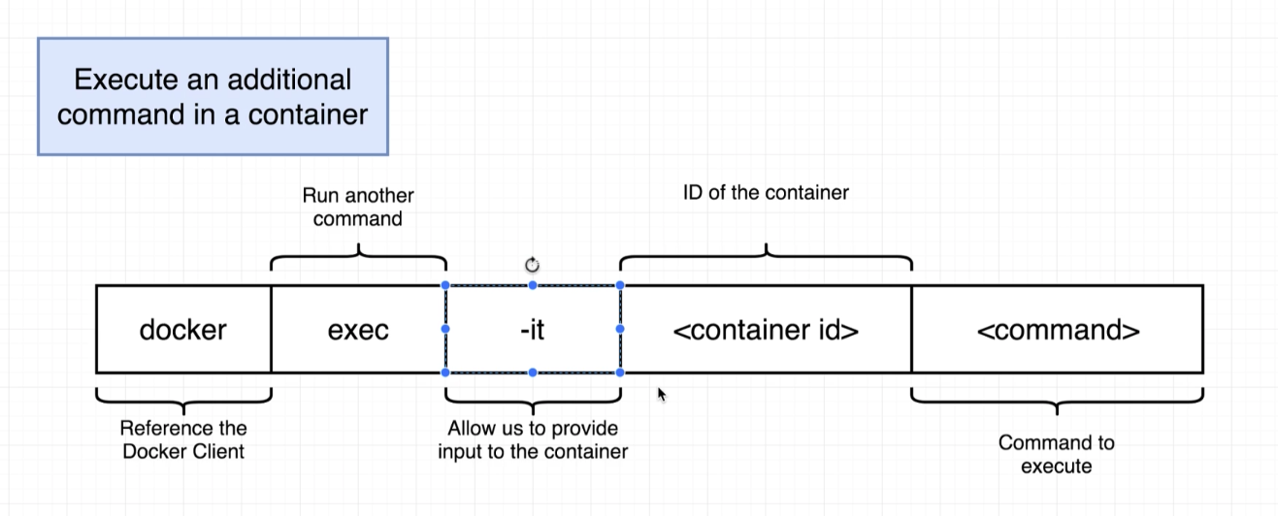
Executing the commands in container

Slide 18
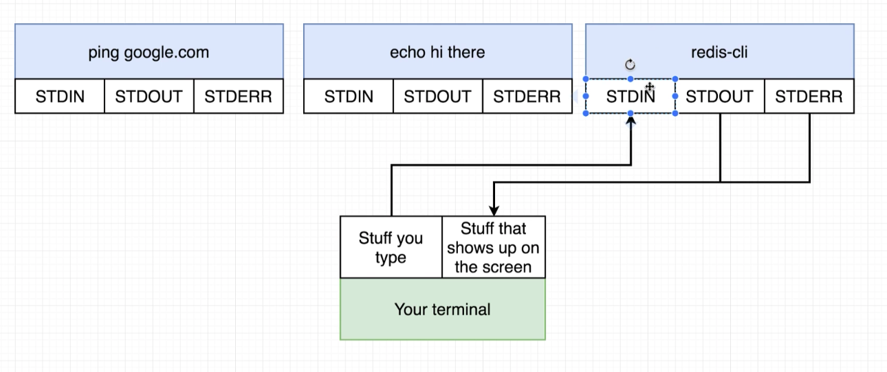
Executing the commands in container
$ docker exec –it <container id> <command to be executed>
What happens without flag –it
$ docker exec <containerid> <command to be executed>

Slide 19
Executing the commands in container
$ docker exec –it <containerid> sh

Slide 20
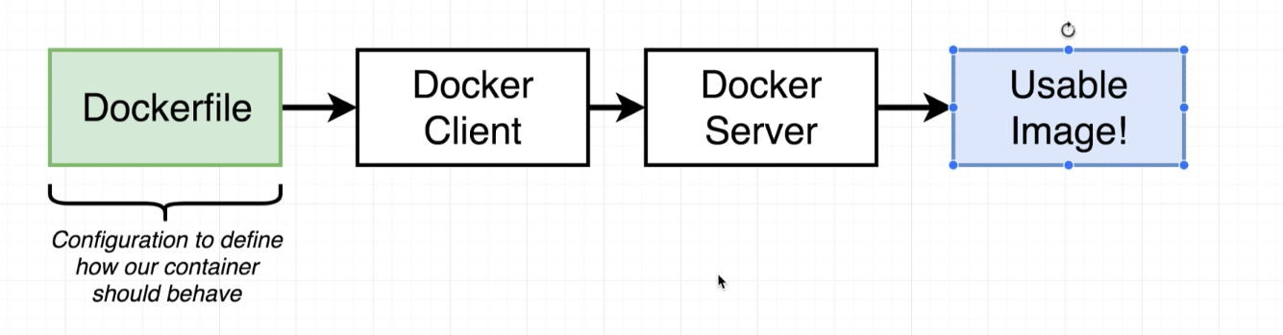
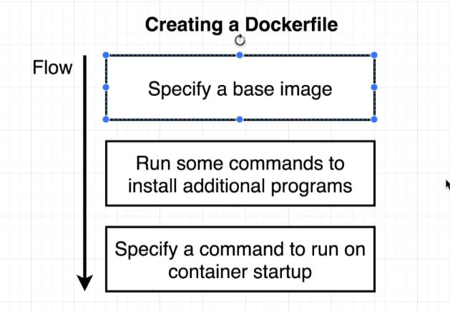
Creating docker images

Slide 21
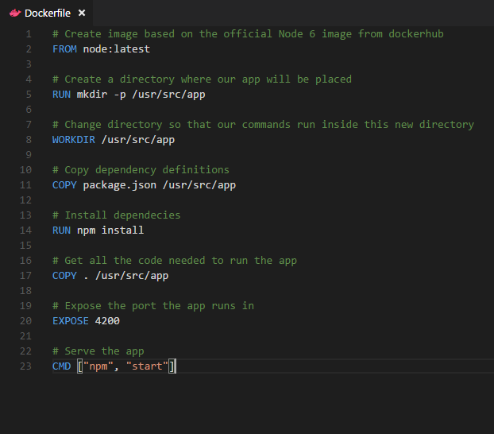
Dockerfile – Linux Example
Go Program
Create Node JS
Write Docker file
Build Image
Run the image
14

Slide 22
Each Dockerfile Command Creates a Layer
…
EXPOSE
COPY
WORKDIR
RUN
FROM
Kernel

Slide 23
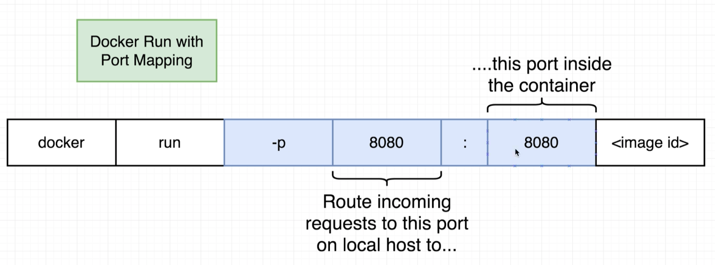
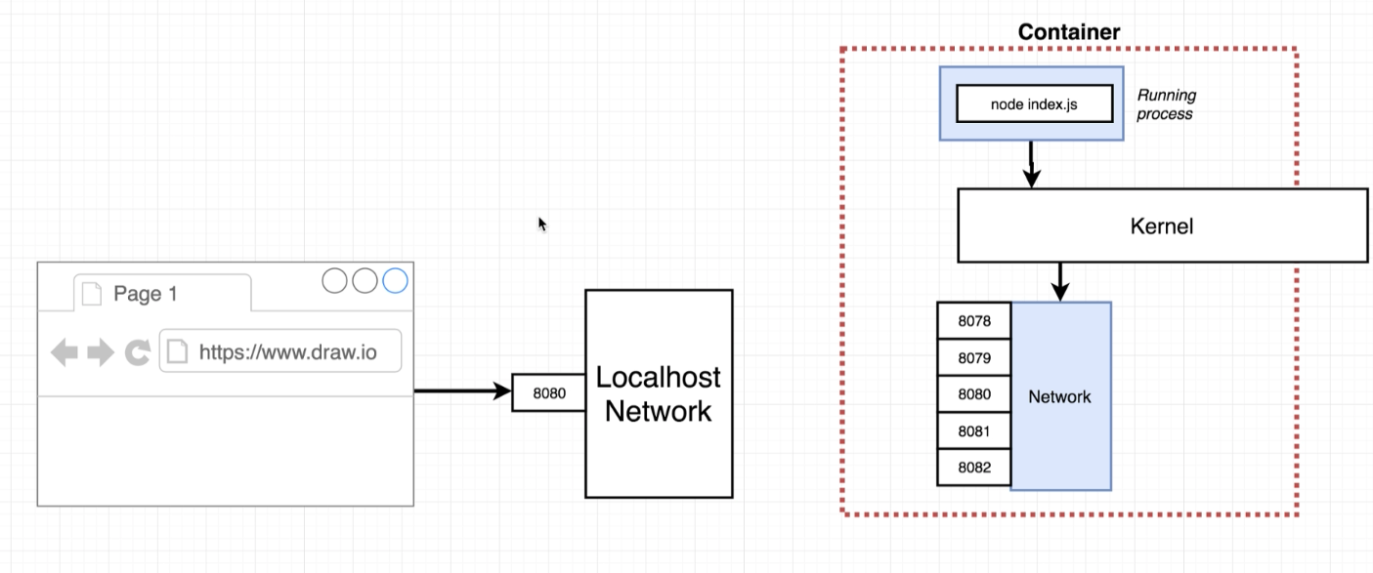
Docker Network
$docker run –it –p <localport>:<dockerport> image

Slide 24
Docker Hub
$docker login
$docker push
$docker pull sabarishg/ninjatest
$docker run –it –p 8009:3000 sabarishg/ninjatest:latest

Slide 25
Section 4:
Docker Compose
Docker Swarm vs K8s

Slide 26


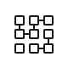
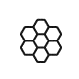
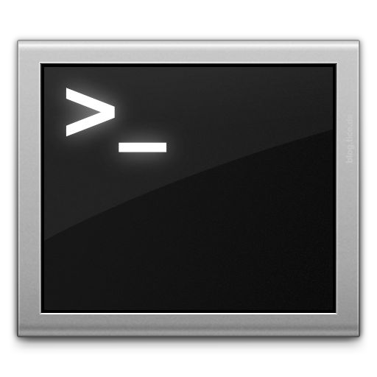







Docker Compose: Multi Container Applications
Build and run one container at a time
Manually connect containers together
Must be careful with dependencies and start up order
Define multi container app in compose.yml file
Single command to deploy entire app
Handles container dependencies
Works with Docker Swarm, Networking, Volumes, Universal Control Plane
49

Slide 27
K8’s vs Docker Swarm
Cluster Strength is stronger in case of K8’s
K8’s cluster is more secure the way it is designed

Slide 28
K8’s vs Docker Swarm
Cluster Strength is stronger in case of K8’s
Scalability though faster in swarm, auto scaling makes it less useful
K8’s cluster is more secure the way it is designed
Along with HELM it is very easy for rollback
Kubectl makes easy for k8s log

Slide 29
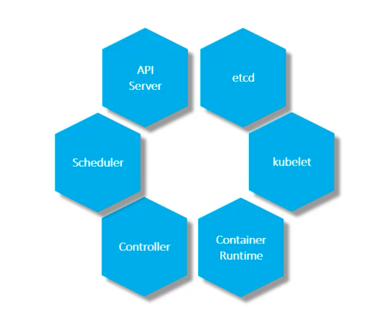
K8 Components

Slide 30
K8s components
kube-apiserver
The API server is a component of the Kubernetes control plane that exposes the Kubernetes API. The API server is the front end for the Kubernetes control plane.
kube-proxy
kube-proxy is a network proxy that runs on each node in your cluster, implementing part of the Kubernetes Service concept.
etcd
Consistent and highly-available key value store used as Kubernetes' backing store for all cluster data.
kubelet
An agent that runs on each node in the cluster. It makes sure that containers are running in a Pod.
kube-scheduler
Control plane component that watches for newly created Pods with no assigned node, and selects a node for them to run on.
Container runtime
The container runtime is the software that is responsible for running containers.
kube-controller-manager
Control Plane component that runs controller processes.

Slide 31
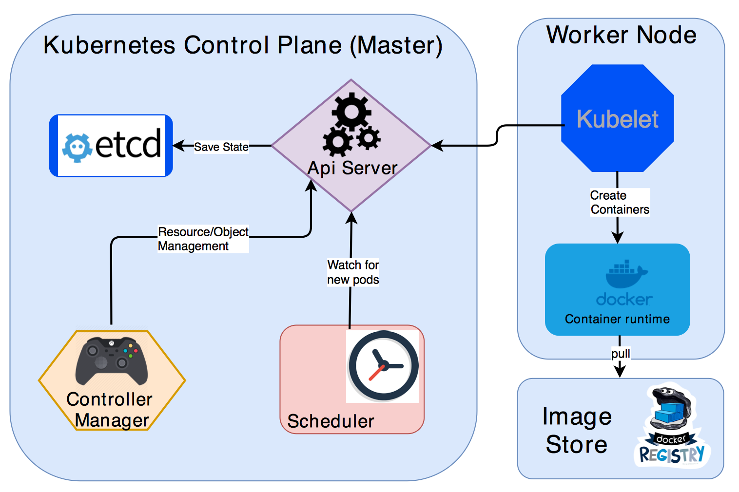
Architecture

Slide 32
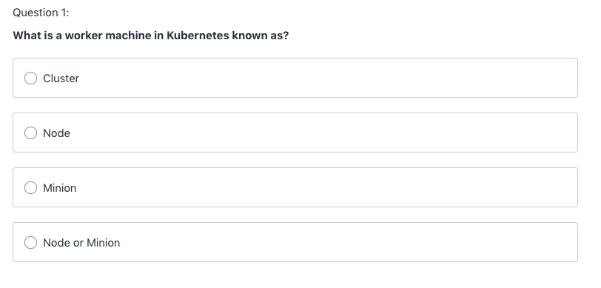
Quiz

Slide 33
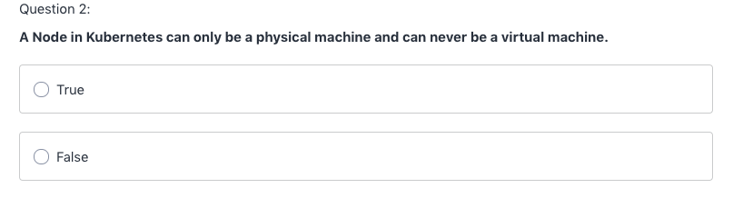
Quiz

Slide 34
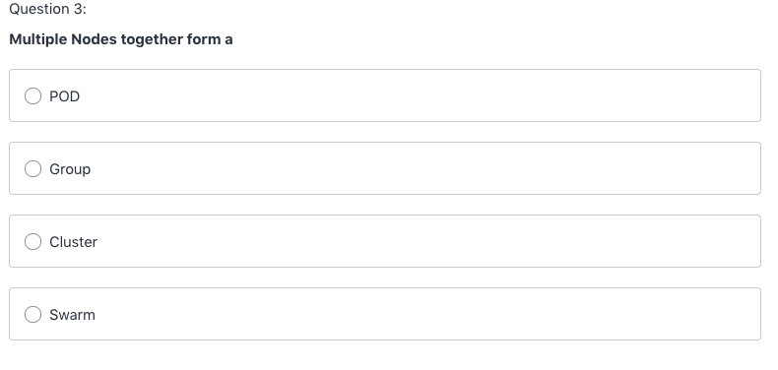
Quiz

Slide 35
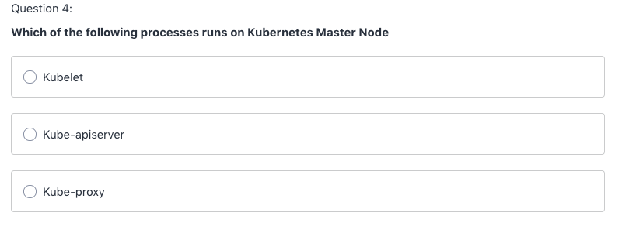
Quiz

Slide 36
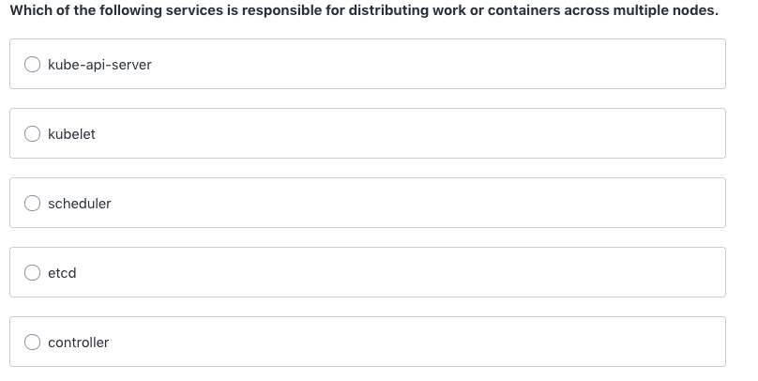
Quiz

Slide 37
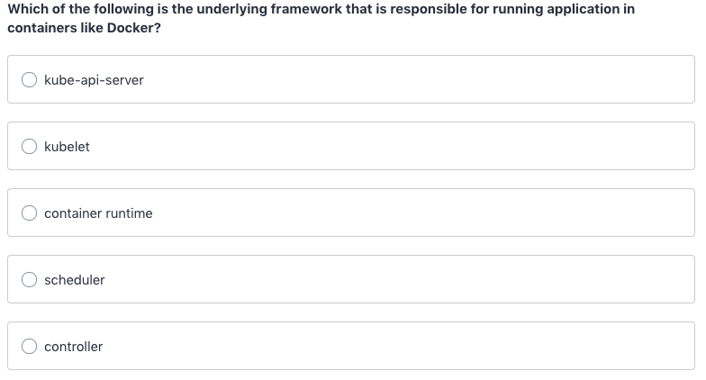
Quiz

Slide 38
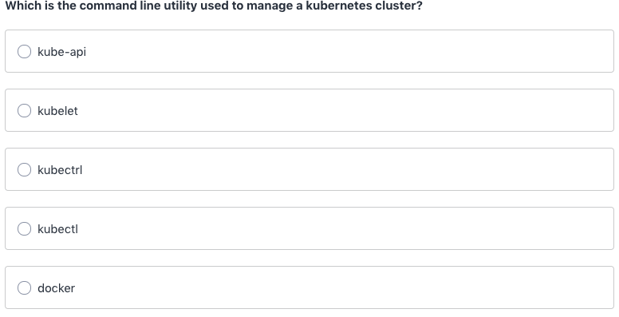
Quiz

Slide 39
Cloud components
Node: A physical machine in term of cloud it is virtual machine(minion)
POD: a smallest unit in kubernetes orchestration
Replica set: Controls no of replicas of pod
Deployment: Manages replica set with set of instructions
Cluster: Collection of nodes
Container: An image in execution
Namespace: Environments inside nodes

Slide 40
K8 Layers
Cluster
Cluster
Node
Namespace
Deployment
Replica set
Pod
Container

Slide 41
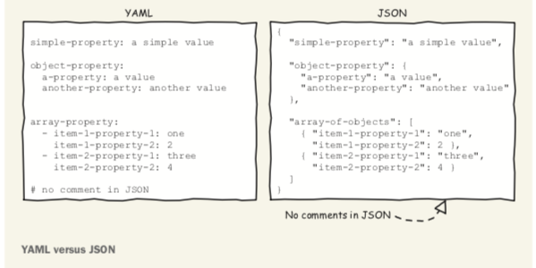
Basic requirements
Docker images
Yaml
Kubectl commands
Important tags of kubernetes yaml
apiVersion
kind
metadata
spec

Slide 42
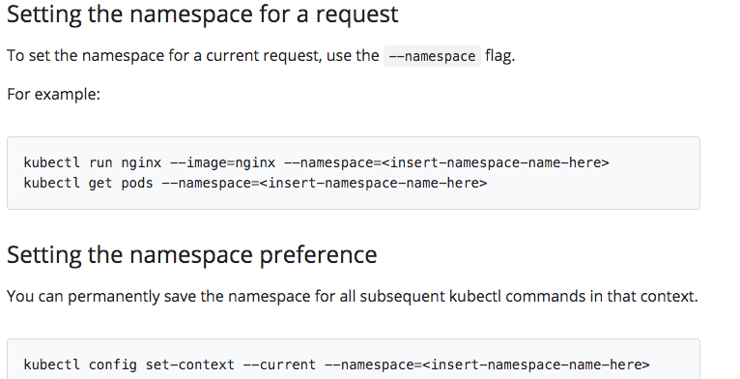
Namespace
Virtual partition inside your cluster

Slide 43
POD

Slide 44
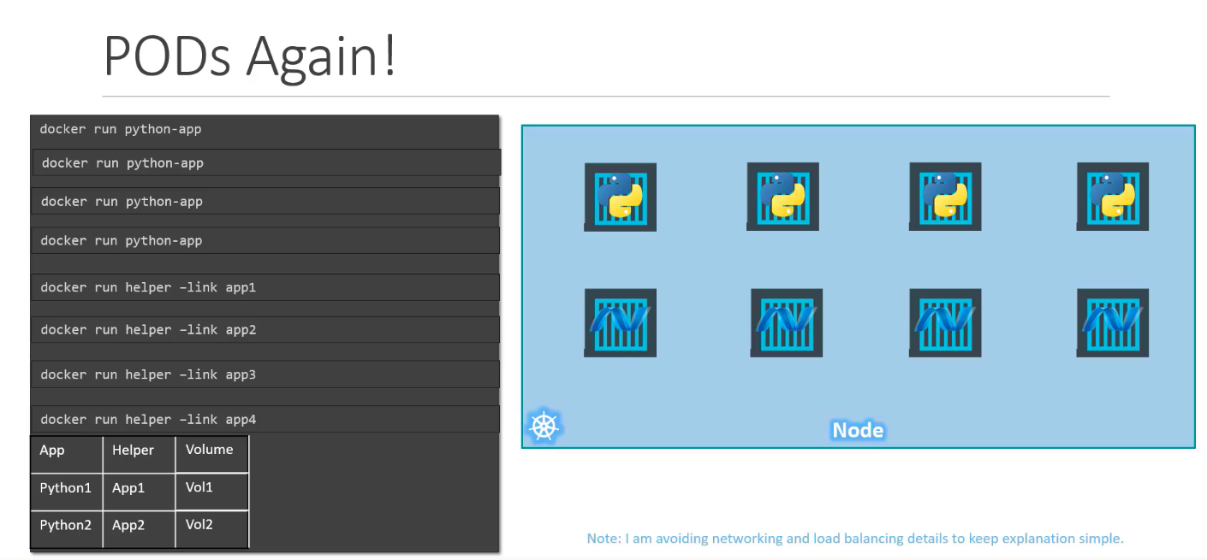

Slide 45
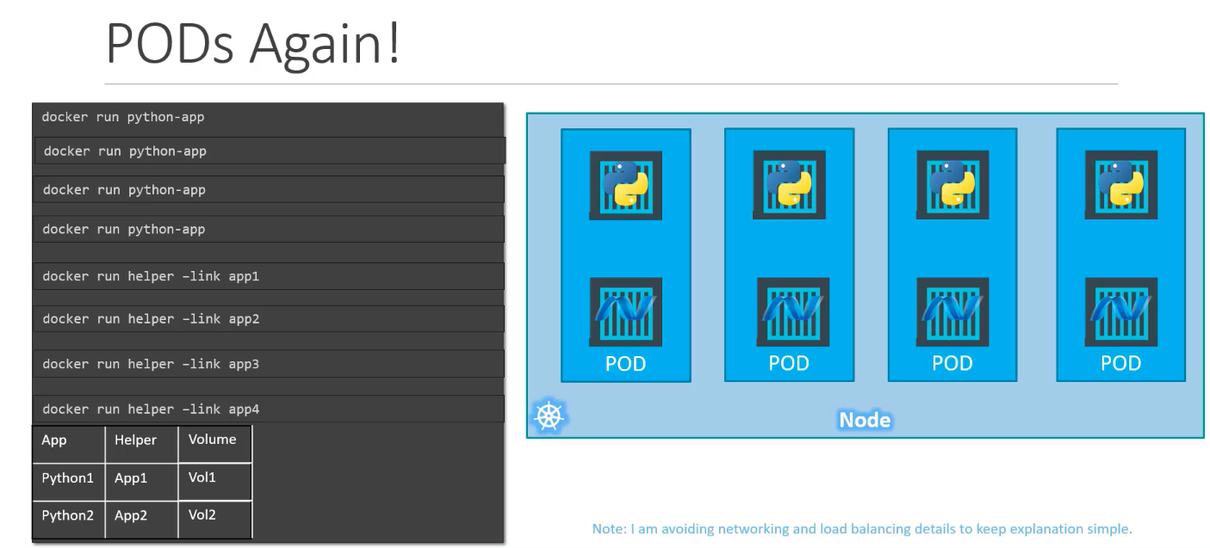

Slide 46
POD
Imperative:
Kubectl run <podname> --image=<image name>
Kubectl describe pod <podname>
Kubectl edit pod <podname>
***********
Kubectl create –f pod.yaml
Kubectl delete pod <podname>
Declarative:
apiVersion: v1
kind: Pod
metadata:
name: mynewpod
labels:
app: mypod
spec:
containers:
- name: nginx
image: nginx
apiVersion: v1
kind: Pod
metadata:
name: mynewpod
labels:
app: mypod
spec:
containers:
- name: nginx
image: nginx
- name: redis
image: redis

Slide 47
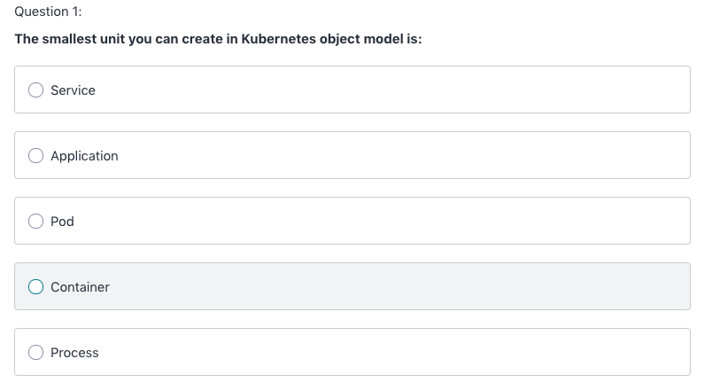
Quiz

Slide 48
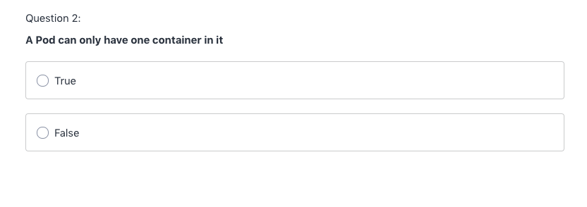
Quiz

Slide 49
Replica set
apiVersion: apps/v1
kind: ReplicaSet
metadata:
name: frontend
labels:
app: mywebsite
tier: frontend
spec:
replicas: 4
template:
metadata:
name: myapp-pod
labels:
app: myapp
spec:
containers:
- name: nginx
image: nginx
selector:
matchLabels:
app: myapp

Slide 50
Deployment
apiVersion: apps/v1
kind: Deployment
metadata:
name: frontend
labels:
app: mywebsite
tier: frontend
spec:
replicas: 4
template:
metadata:
name: myapp-pod
labels:
app: myapp
spec:
containers:
- name: nginx
image: nginx
selector:
matchLabels:
app: myapp
kubectl create deployment <deploym name> --image=<image name>
kubectl scale replicas=<NO> deployment/<name of deployment>

Slide 51
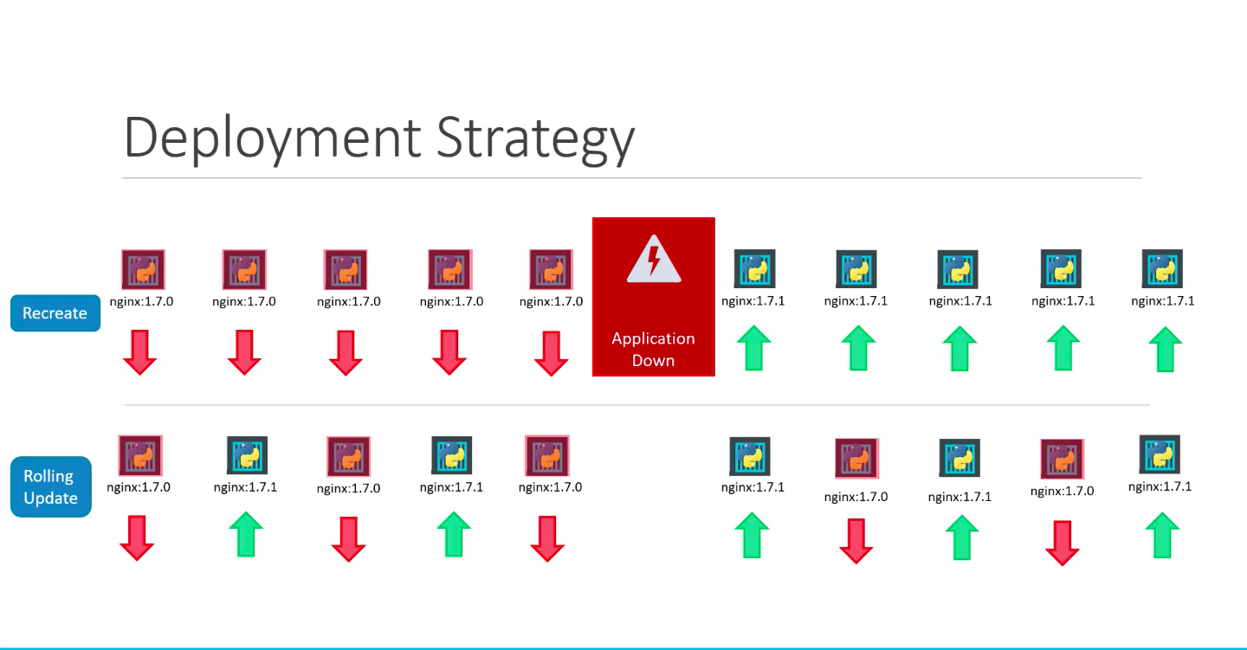
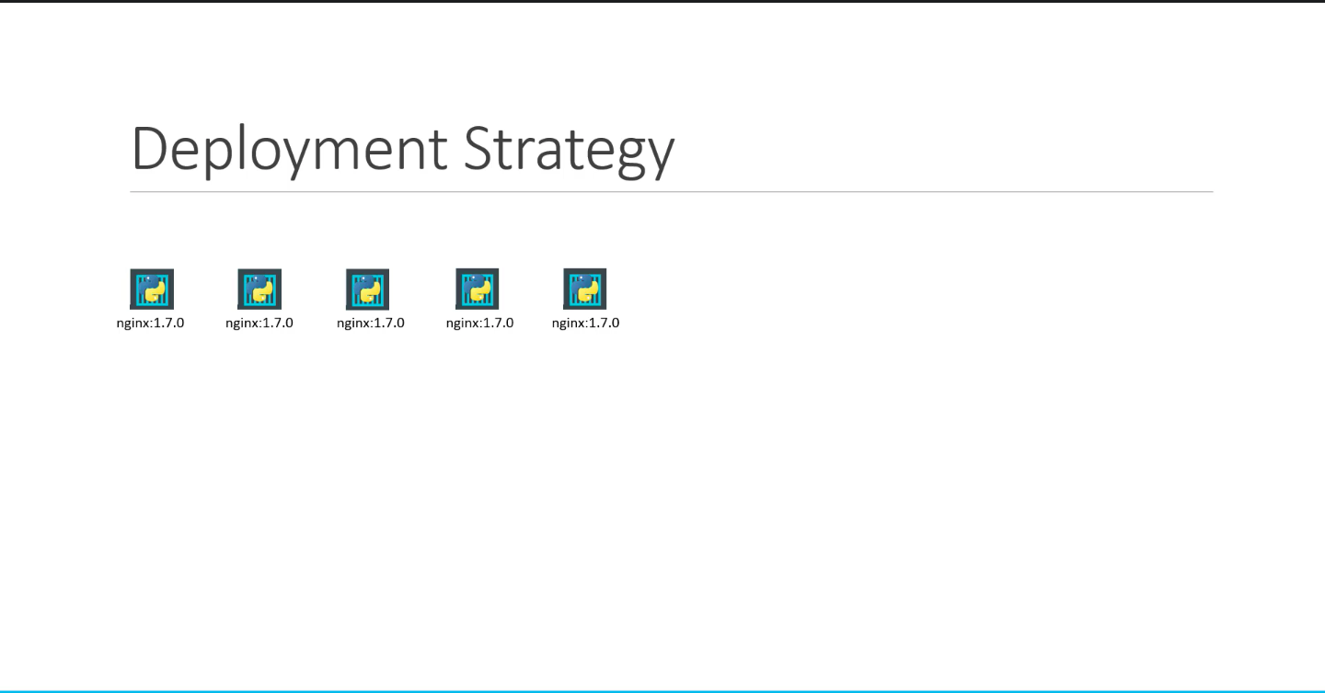
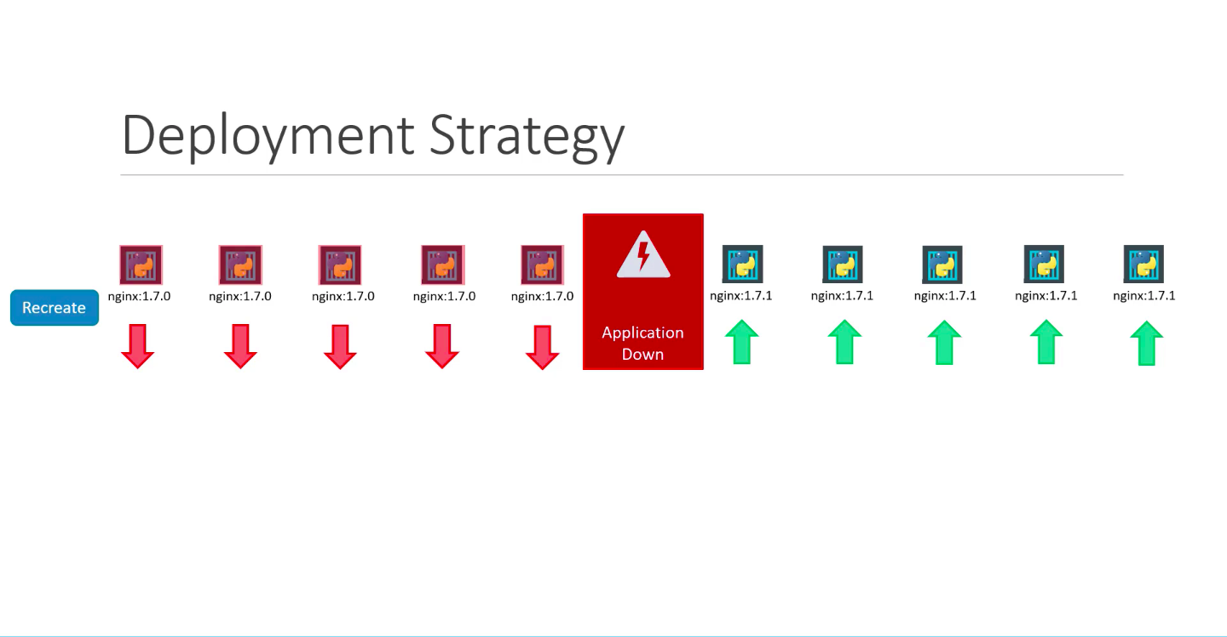
Deployments – Rolling updates and Roll back

Slide 53
Quiz
I created a pod “my pod” and pod stopped working, kubernetes will
ensure always one pod is running, even if this pod is deleted.
True B. False
Once I have declare a replica set with replicas as 6 I cannot amend it any
further?
True B. False
3. I created a pod “my pod” with rs (5) “replica pod” and one of the pod
stopped working, kubernetes will ensure always one pod is running, even if
this pod is deleted.
True B. False
4. I can use below command which will increase my pod count
kubectl scale –replicas=6 pod/<name of pod>
A. True B. False

Slide 54
Service
Node Port
Cluster IP
Load Balancer
kubectl get service my-cip-service --output yaml → gives details in yaml format
kubectl get svc –o wide → give details including which node the service is running
kubectl exec –it <pod name> -- sh → go in to pod and check details
curl <cluster ip>:80 → to get details at cluster level
gcloud compute firewall-rules create <nameof firewall> --allow tcp:<node-port>

Slide 55
Kubectl Commands
Create – to create pod, deployment, namespace
Apply – if you have amended and need to update
EDIT – if you have to update any yaml file
Delete – to delete
Logs – to check logs of any objects
Scale – to scale replica set, deployments
Auto scaling – to set min, max of your resources
kubectl autoscale deployment my-deployment --cpu-percent=50 --min=1 --max=10
Describe – to know in details about your objects
Get – to get details about your objects running in cluster

Slide 56
Quiz
To make use of your service outside any cloud environment you have to use type as
LoadBalancer
NodePort
ClusterIP
2. Which command is used to list all the objects running inside your namespace?
3. Which command is used to know what image is running inside a container?
4. If I wanted to know on which node my service is running which command I can use?
-o wide
-o node
5. I can delete a container running inside a pod without disturbing a pod
True
False
6. Which among the following will collapse the objects completely
Deleting Pod
Deleting replica set
Deleting Deployment

Slide 57
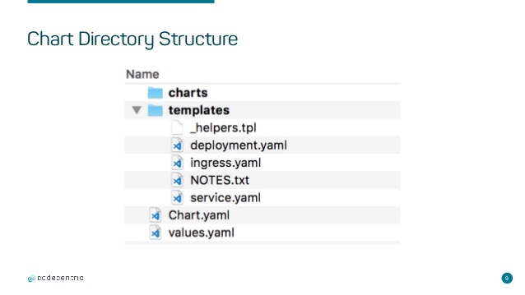
HELM & Tiller
Helm helps you manage Kubernetes applications — Helm Charts help you define, install, and upgrade even the most complex Kubernetes application.
Tiller is the service that actually communicates with the Kubernetes API to manage our
Helm packages

Slide 58
HELM DEMO
Easy yaml writing
Kubectl create deployment <name> --image=<imagename> --dry-run –o yaml > de.yaml
kubectl expose deployment <name> –port 80 –dry-run –o yaml > ser.yaml
Chart.yaml
apiVersion: v1
name: bitesize
version: 0.1.0
appVersion: 1.0
description: bitesize demo
List
Upgrade
Rollback
delete

Slide 59
QUIZ
Helm can communicate directly with kubernetes.
True B. False
2. Which Helm command will help us to get whole helm structure?
Upgrade B. List C. Create D. Install
3. What is the argument we need to pass in Helm rollback command?
4. If you delete helm release still pod will be running
A. True B. False

